Slide 1
Outlet Works Rehab. Items
Build Access Road
Drain lake
Reline Existing 8” CMP with CIPP
Replace Outlet Gate and Lift Equipment
Erosion Repair and Riprap

Slide 2
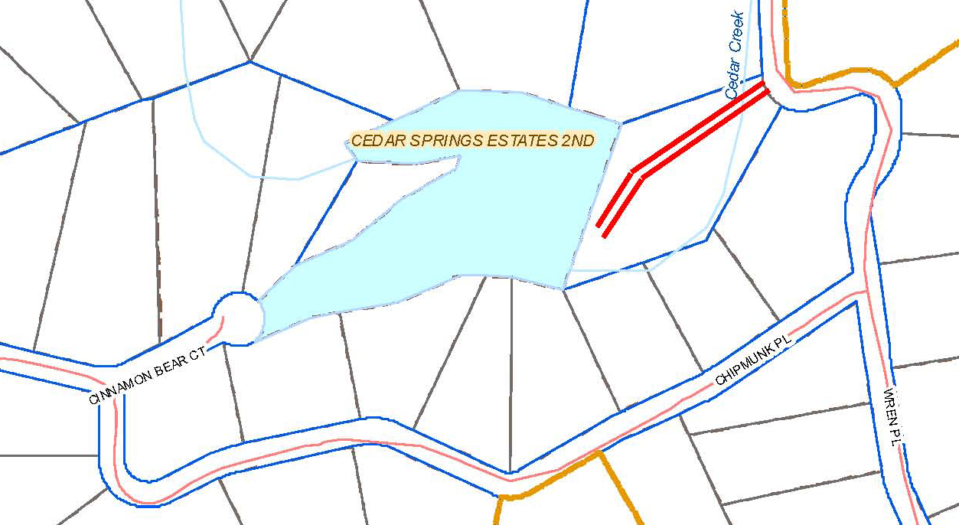
Outlet Works Rehab. Items
Build Access Road

Slide 3
Outlet Works Rehab. Items
Drain lake
- Draining will take approx. 10 days.
- Need to do additional analysis to predict whether draining will effect wells.
- Drain in Fall, Refill During Winter or Spring.

Slide 4
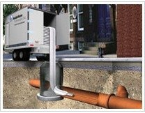
Outlet Works Rehab. Items
Reline Existing 8” CMP with CIPP

Slide 5
Preliminary CIPP Liner Design
Using the Marston Formula and the Boussinesq Formula
Min. thickness of liner = 0.247”

Slide 6
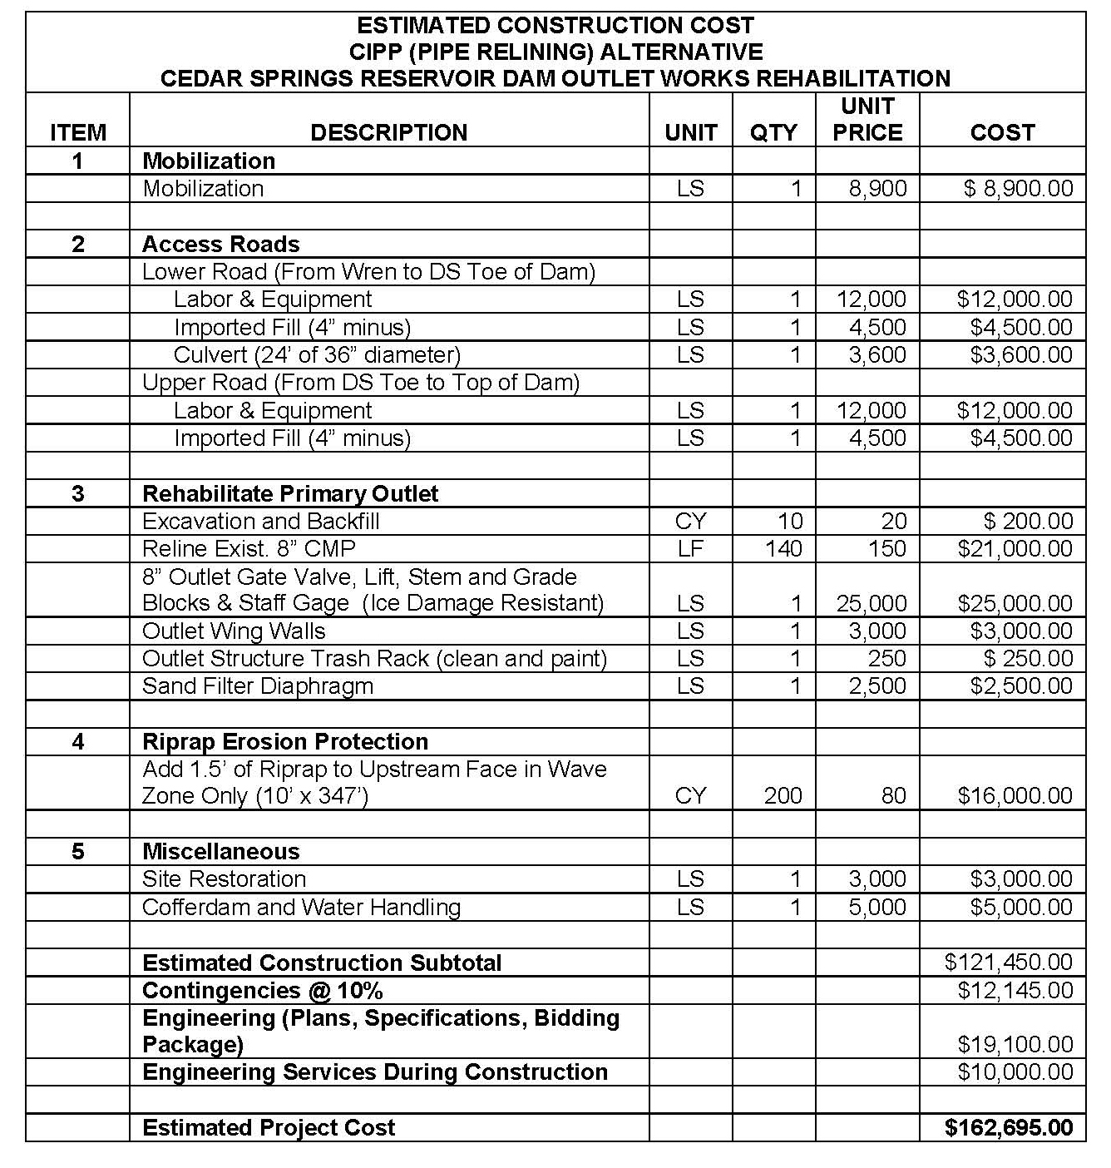

Slide 7
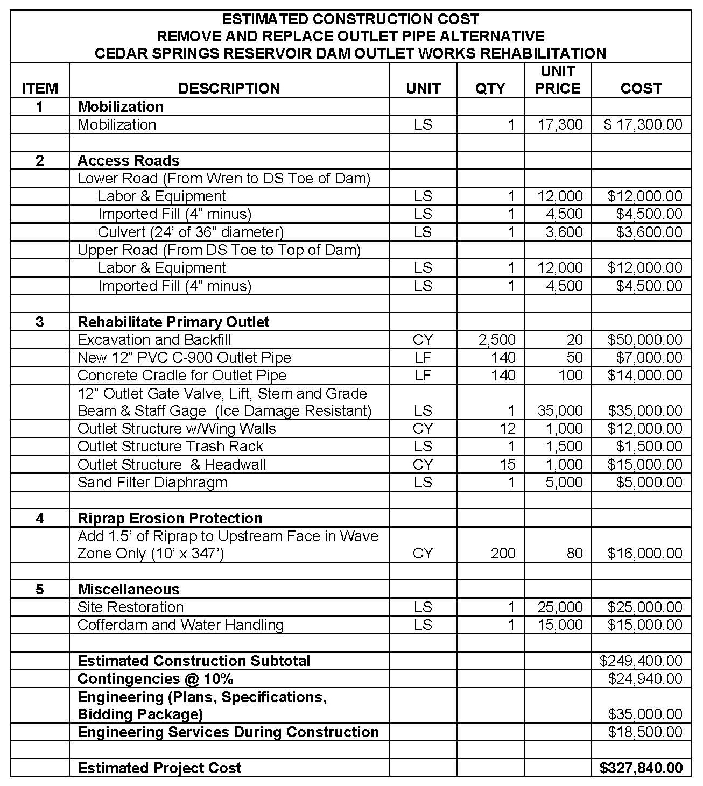

Slide 8
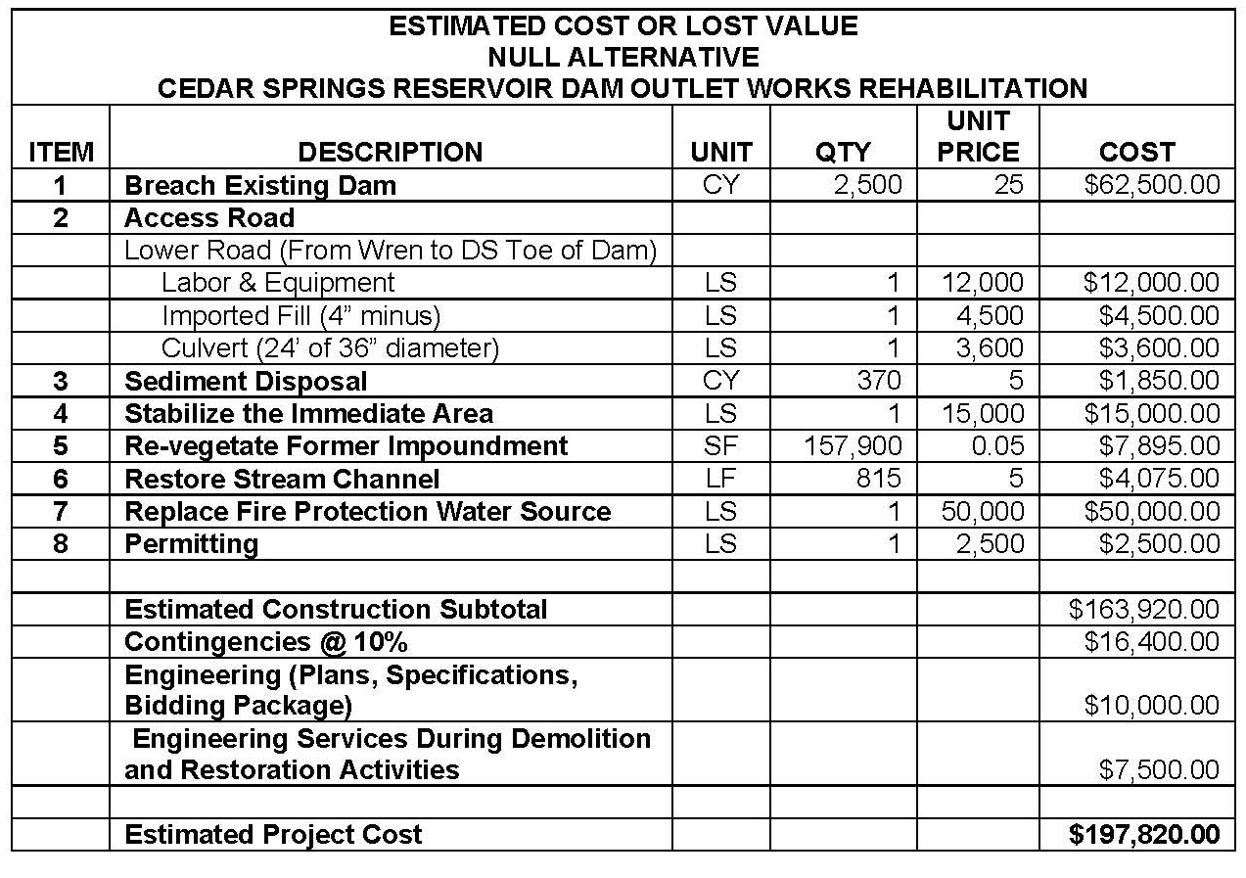

Slide 9
Outlet Works Alternate Summary
Reline Existing 8” CMP with CIPP
$162,695
Remove and Replace Existing CMP
$327,840
Null Alternative (Abandonment)
$197,820
Abandoned Water Right Value
$178,000

Slide 10
Outlet Works Rehab. Items
Erosion Repair and Riprap

Slide 11
Fire Protection Considerations
Fire on Your Property
Wildland Fire
Pay More for Fire Insurance
Trouble Obtaining Fire Insurance

Slide 12
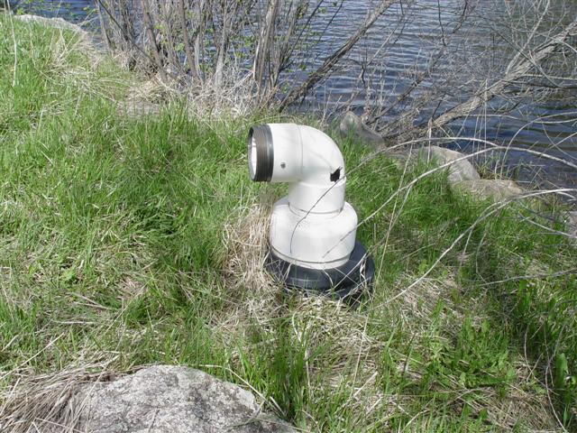
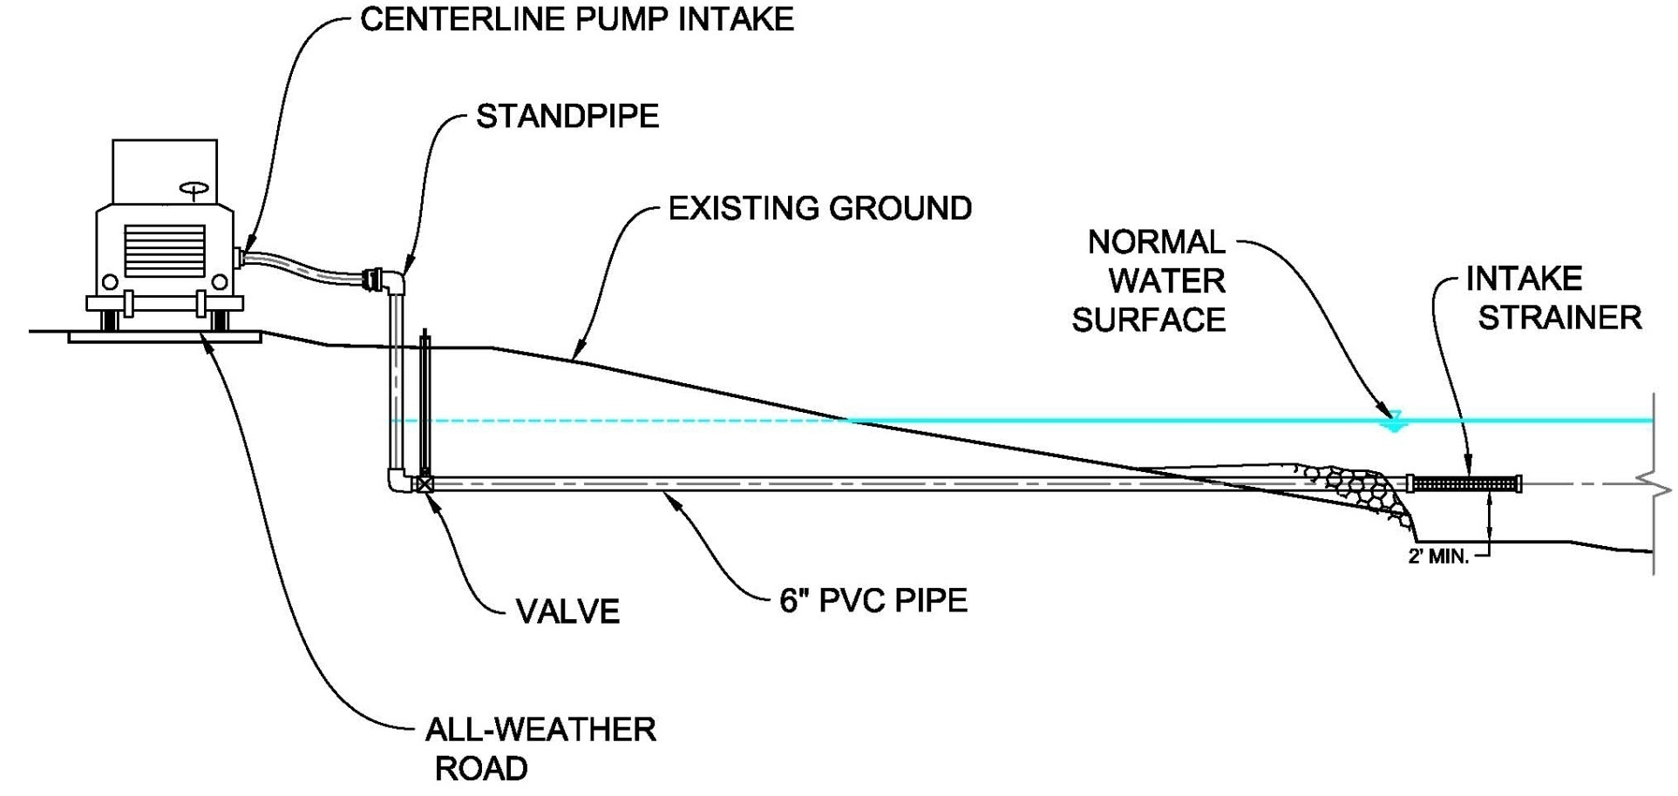
Dry Hydrant

Slide 13


Slide 14
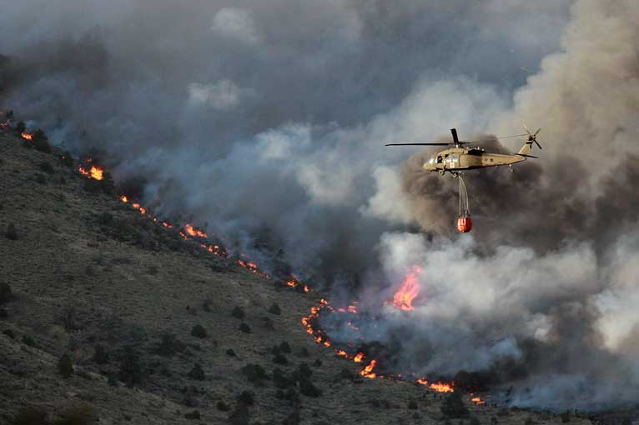

Slide 15
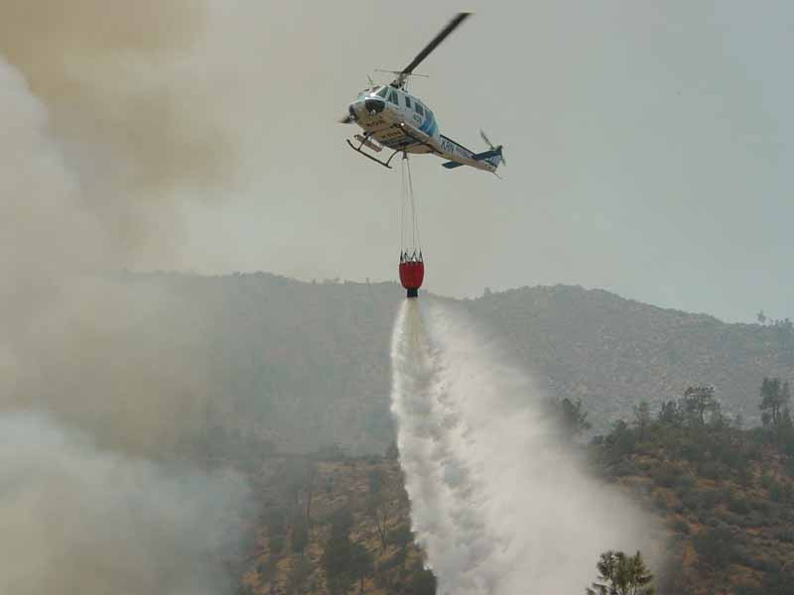

Slide 16
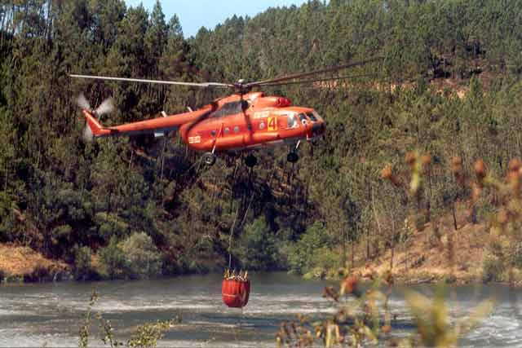

Slide 17
Regulatory Agency Cooperation
State Engineer’s Office for Dam Safety
State Engineer’s Office Water Commissioner
USACE
State Division of Wildlife
Larimer County

Slide 18
Finance and Funding
Colorado Water Conservation Board
USDA Rural Development

Slide 19
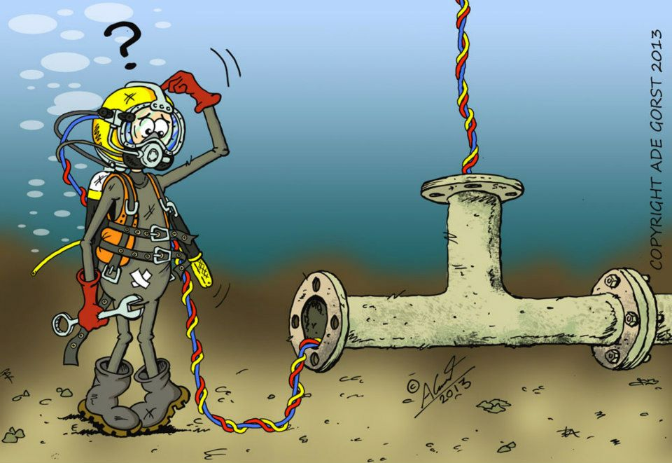
Questions?

Slide 20
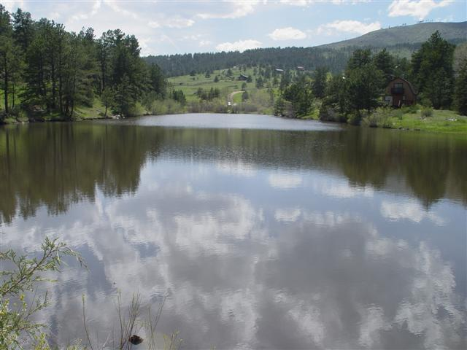

Slide 21
Dam Resume
Dillon Dam 257,304 AF
Meadow Lake Dam 32 AF
Comanche 2,628 AF
Hourglass 1,693 AF
Barnes Meadow 2,349 AF
Twin Lakes 278 AF
Peterson 1,183 AF
Milton Seaman 5,008 AF
Boyd Lake 50,000 AF
Horseshoe 7,500 AF
Lake Loveland 14,000 AF
Houts/Equalizer
Lower Hoffman
Tahosa Dam 118 AF
Panhandle
Port Arthur. Tx. Hurricane Protection (36 Miles Long)

