Slide 1
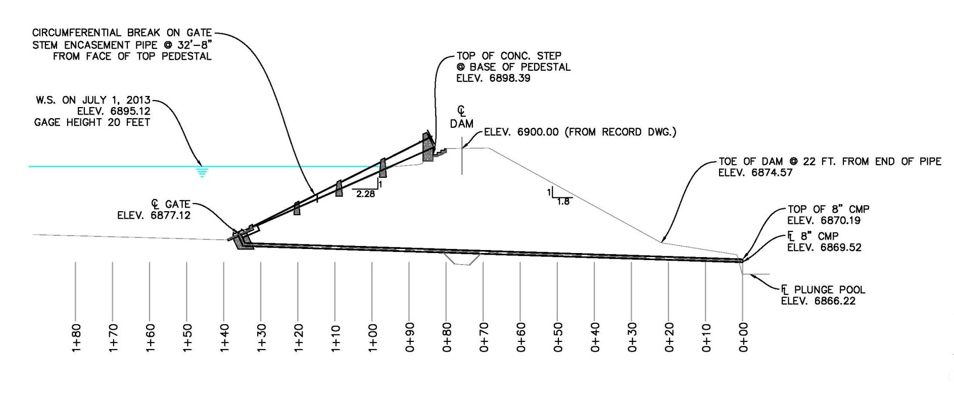
Video Inspection of Outlet Pipe

Slide 2
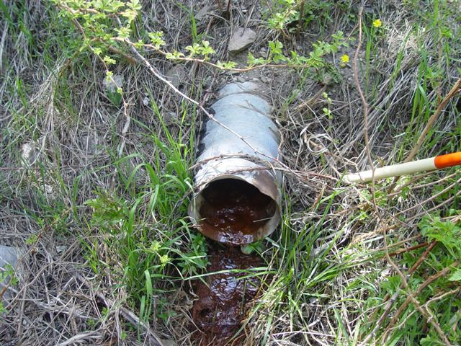
Video Inspection of Outlet Pipe

Slide 3
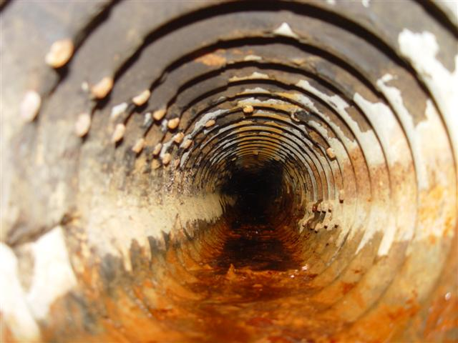
Downstream End Of Outlet Pipe

Slide 4
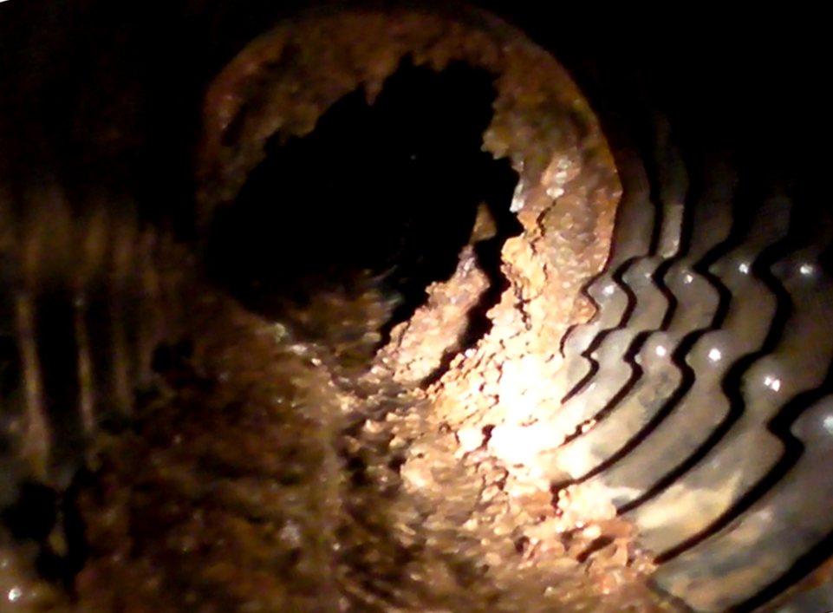
Middle Of Outlet Pipe

Slide 5
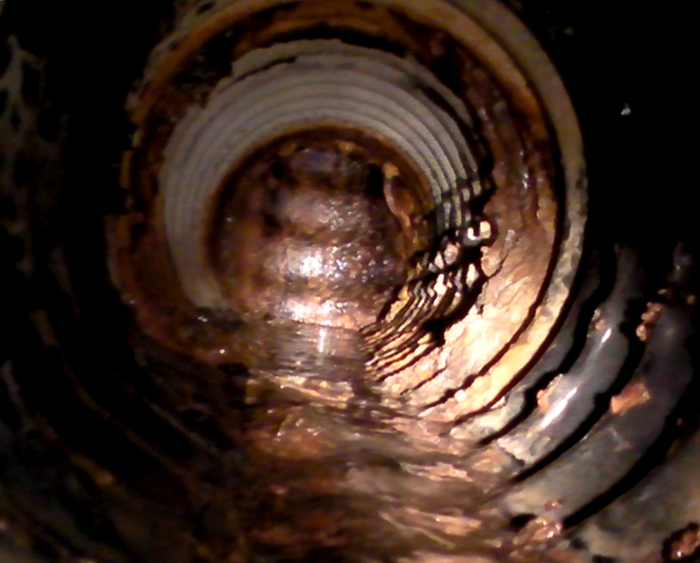
Upstream End Of Outlet Pipe

