Slide 1
CEDAR SPRINGS DAM IMPROVEMENTS
John G. Gauthiere, P.E.

Slide 2
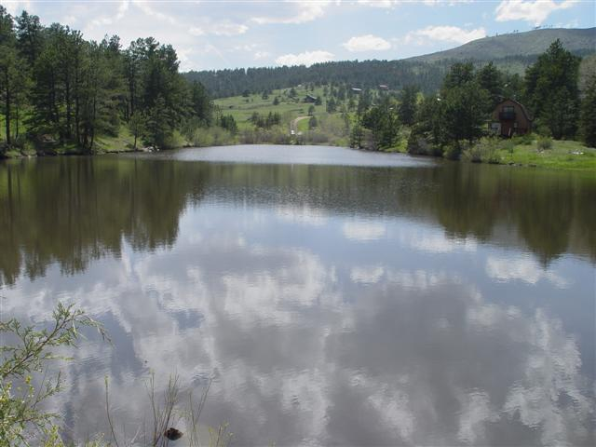
Cedar Springs Dam Background
Important Fire Protection Water Source for Cedar Springs
Provides Residents with Various Recreational Opportunities
Aesthetics
Habitat for Fish and Wildlife
Increases Real Estate Values
Fire Insurance Cost Influence

Slide 3
Cedar Springs Dam Facts
Dam was completed in 1969
Lake covers 3.6 surface acres @ 6,900’
Lake holds 38.12 acre-feet or 12,400,000 MG of water
Filled by 1,670 acre drainage basin and various springs
Regulated by the State Engineer’s Office for Dam Safety – Low Hazard

Slide 4
Cedar Springs Dam Facts
Adjudicated water right of 38.12 acre-ft.
Water Court Case No. W-7530
Appropriation date is June 25, 1968
Decreed for domestic use, stock watering, piscatorial, recreational, municipal use, and irrigation

Slide 5
Dam Maintenance Issues
Last inspection by State - Dec. 5, 2012
The valve stem is bent due to ice action
Erosion is occurring around and under the concrete valve pedestal
Valve not been operated in several years
Corrugated metal pipe outlet is 44-years old
Need to provide additional riprap
Brush and tree removal required on dam

Slide 6
Inspections
Video the internal condition of the dam outlet pipe
Dive inspection of the outlet gate, gate stem, lift equipment and vent pipe

Slide 7
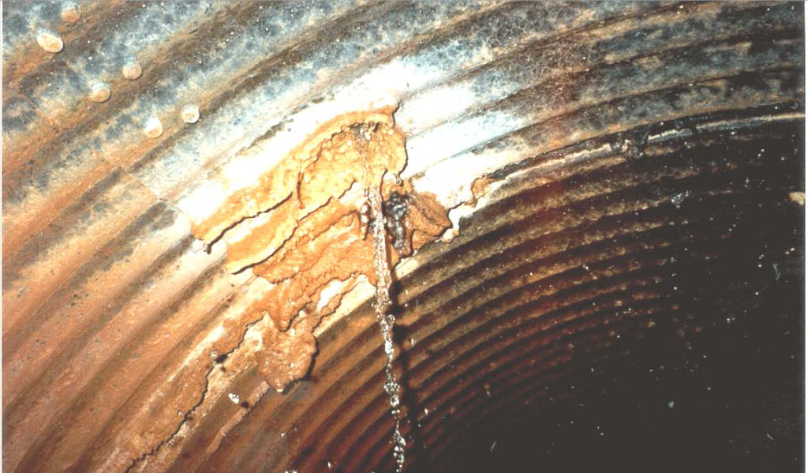
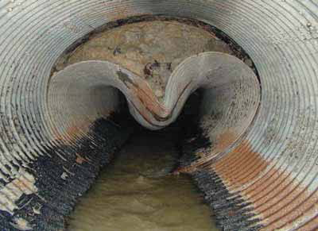
Examples of Outlet Pipe Failure

Slide 8
Undetected Corrosion of CMPs Is One of the Primary Causes of Dam Failure

Slide 9
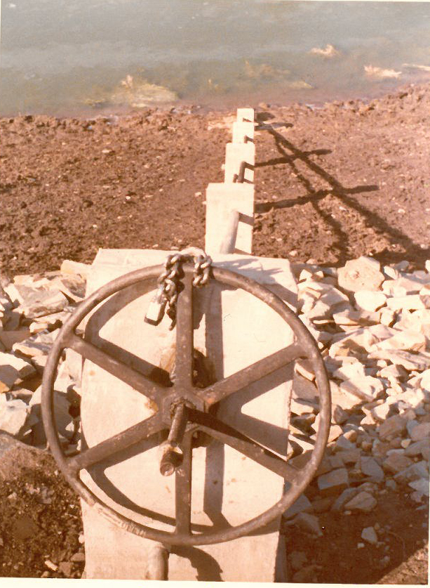
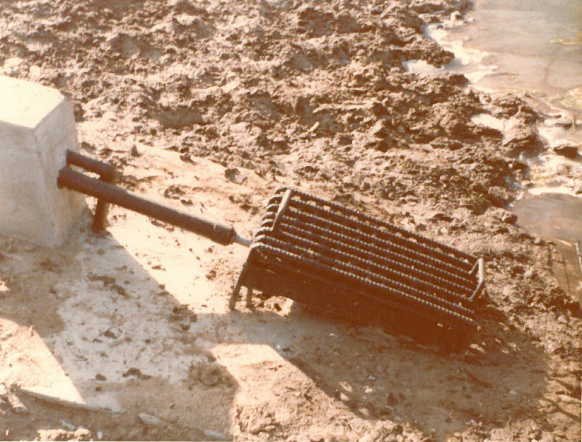
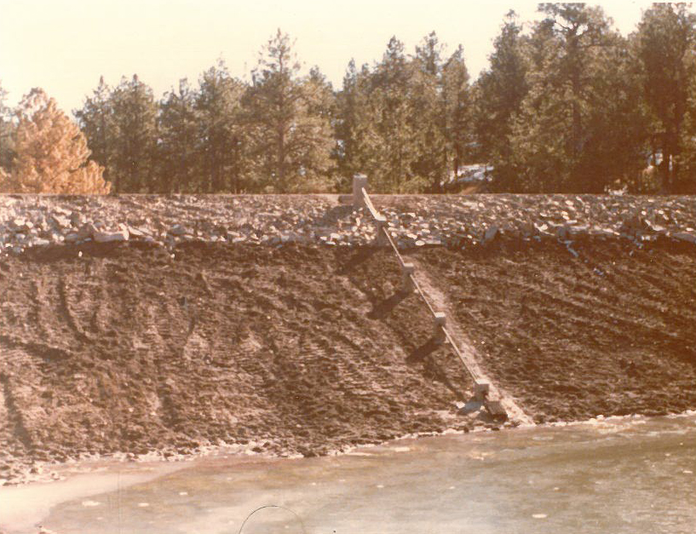
Dive Inspection of Gate and Lift Equipment
1974 Photos

Slide 10

Dive Inspection of Gate and Lift Equipment
FOUR MAN CREW
John Ivie
Dive Engineer
Backup Diver
Comm. Operator

Slide 11
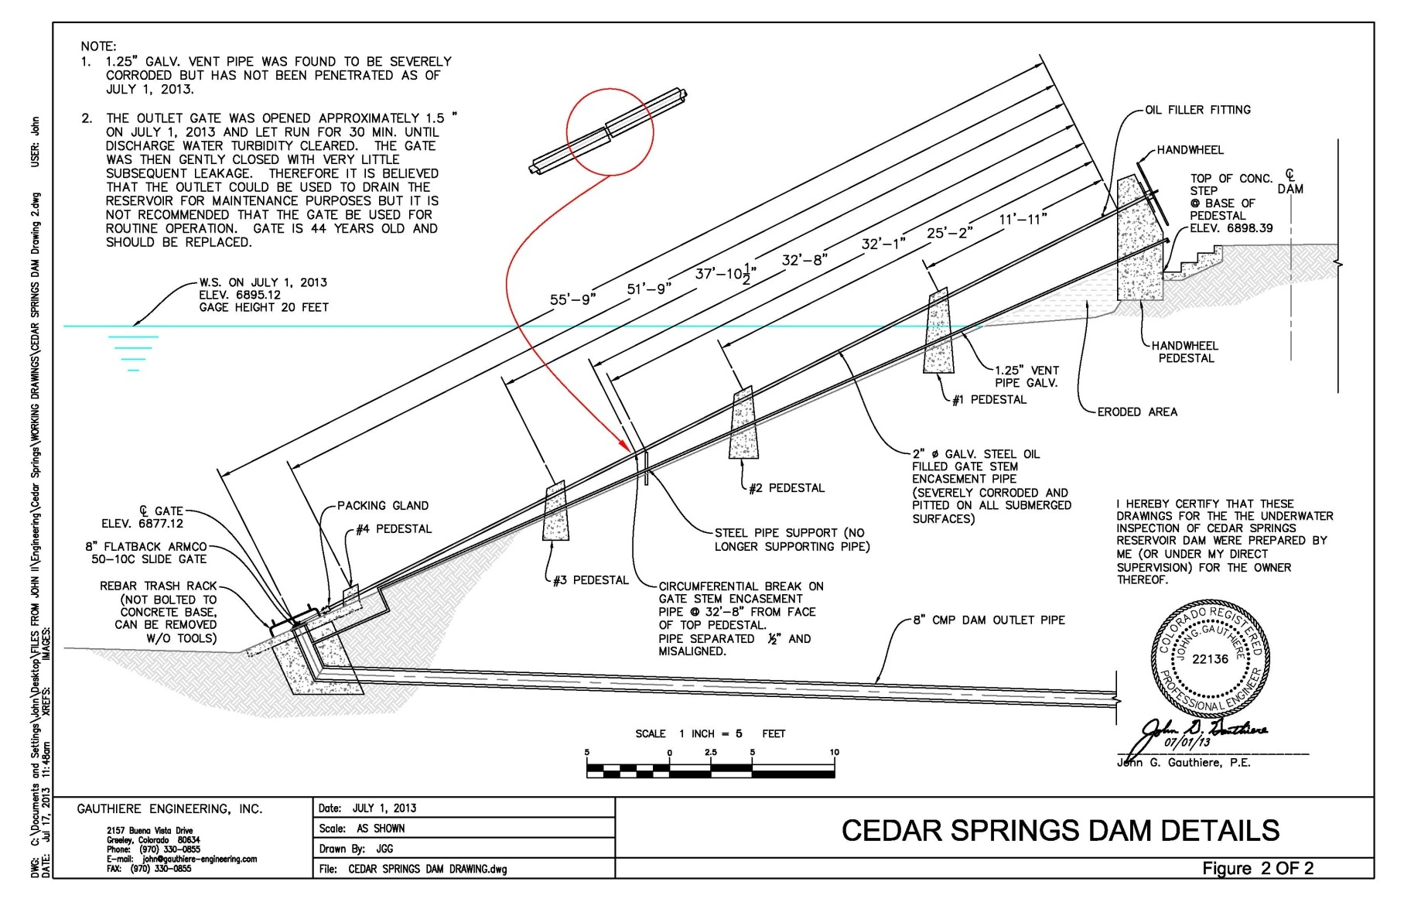
Dive Inspection of Gate and Lift Equipment

Slide 12
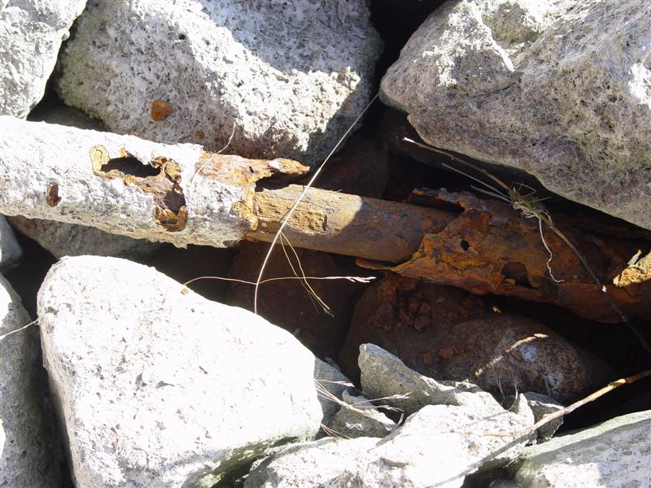
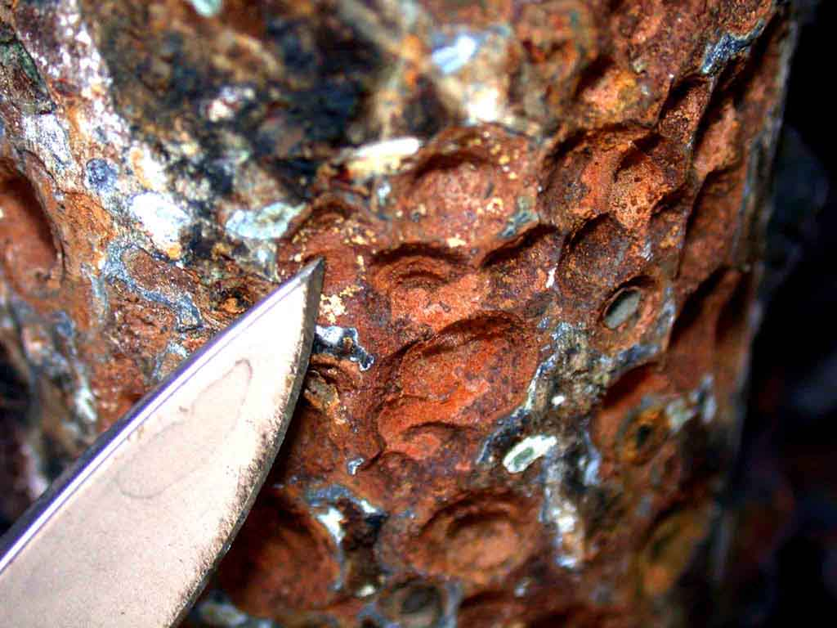
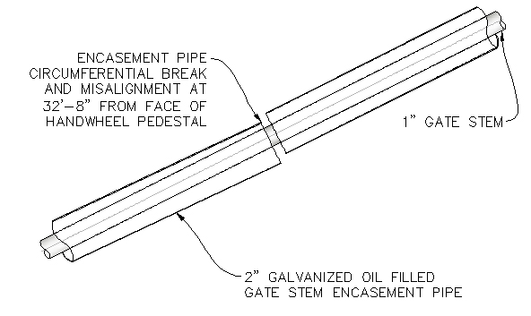
Dive Inspection of Gate and Lift Equipment

